Slide 1
Probation and Health
Standards and Quality Indicators

Slide 2
The Problem
People on probation can’t always access services to meet their health and social care needs
This impacts negatively on them personally
It may also contribute to:
Health inequalities in society
Re-offending
Avoidable use of crisis services like A&E

Slide 3
Why Does This Problem Exist?
Lots of reasons including:
A lack of awareness amongst commissioners about the health and social care needs of people on probation and how they differ from the general population
Associated barriers to service access – for example, being bounced between drug and/or alcohol services and mental health services as services are only designed to cater for one type of need
A need to improve our understanding of what high-quality care for people on probation looks like
Complex health commissioning systems and a lack of awareness of whose responsibility commissioning for people on probation is
Difficulties with continuity of care on release from prison
A general lack of funding for services in the community
People not being registered with a GP.

Slide 4
The Solution
This is a complex picture, but as a starting point, we believe it would be helpful to introduce standards and quality indicators linked to the NPS Health and Social Care Strategy to:
Support the objectives in the strategy
Show what high-quality care looks like and evidence:
Where the right structures, processes and procedures are in place to support high-quality care, and
Where improvements are needed so that we can meet the standards – so probation and health and social care partners can work together to address any gaps
Evidence the health and social care needs of people on probation
Data that can be shared with commissioners to influence what types of services are commissioned.

Slide 5
Characteristic 1: Health and social care needs and need to access services are identified
Screening and assessment tools are incorporated into probation case management systems to enable staff to identify and record the health and social care needs of people on probation.
1. The existence of screening and assessment tools within probation case management systems.
Everyone on probation should be assessed for health and social care needs as soon as possible and asked if they have a GP.
2. The proportion of people on probation completing screening and assessments within 3 weeks of starting probation.
3. The proportion of people on probation that are asked if they are currently registered with a GP.
For every person on probation risk of suicide should be considered.
4. The number of people who have an identified suicide risk recorded in OASys.
5. The number of people who have an identified suicide risk as identified by the Delius risk to self globe recorded.
All those with an unmet need who consent to being referred should be referred to support within two weeks of an assessment.
6. The proportion of people on probation that are identified as having an unmet health and/or social care need that a) consent to being referred for support and b) are subsequently referred by probation within 2 weeks of the assessment.
7. The proportion of people on probation that are not currently registered with a GP that a) consent to being registered and b) are subsequently registered.
8. The proportion of people on probation that are identified as neurodiverse where reasonable adjustments are made to probation practice.
Where risk has been identified (historical & current) an appropriate risk management response is provided.
9. The proportion of people in Approved Premises that have a Support and Safety Plan completed.
10. The number of people who have an identified suicide risk in OASys who are provided with a safety plan.
11. The number of people who have an identified suicide risk as identified by the Delius risk to self globe who are provided with a safety plan.
12. Where current risk of suicide is identified in Approved Premises the proportion of CARE documents that are assessed as satisfactory as part of quality assurance procedures.

Slide 6
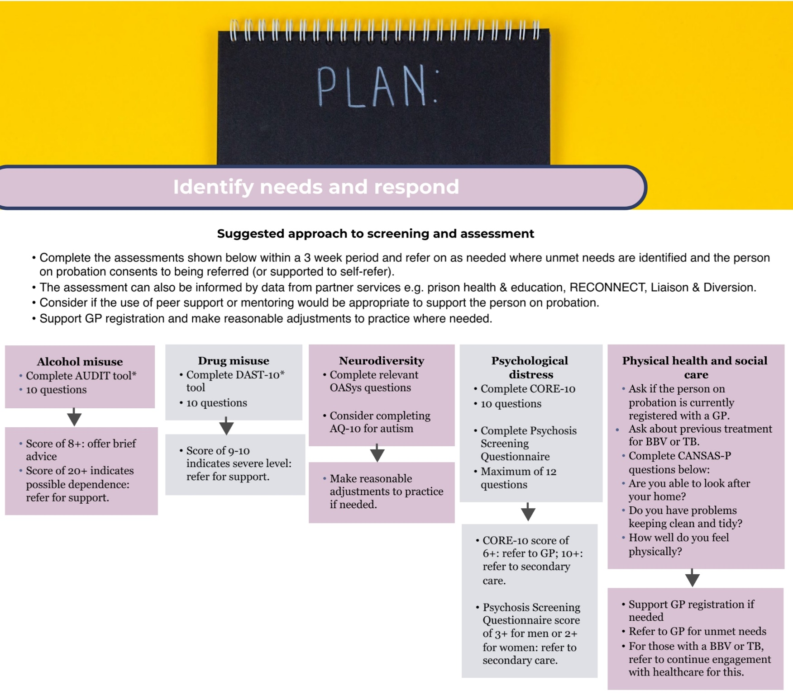

Slide 7
Characteristic 2: Collaborative Working
Check that a healthcare discharge summary has been received for everyone who has been released from prison that includes relevant information on health and social care needs (e.g., from healthcare and education).
The existence of data sharing agreements/processes between prisons, probation, and health and social care providers and commissioners.
14. The existence of data sharing agreements/processes between prisons, probation, and health and social care providers and commissioners .
Policies and procedures for information sharing on risk to self are in place.
15. The existence of policy, processes and procedures between probation, prisons and health for information sharing on risk to self.
16. The proportion of Support and Safety Plans in Approved Premises that are uploaded on to Delius.
Everyone with a blood borne virus or TB leaving or being recalled to prison is supported to continue engaging with healthcare.
17. The proportion of those with a blood borne virus or TB diagnosis leaving or being recalled to prison that are supported to continue engaging with healthcare services.
13. The proportion of people released from prison who have a healthcare discharge summary recorded by a GP or probation.

Slide 8
Characteristic 3: Needs-Led Care
Probation share information on the needs of people on probation with health and social care commissioners
18. The proportion of joint strategic needs assessments that include data on the probation population.

Slide 9
Characteristic 4: Positive, Consistent and Trusting Relationships
The number of times that an individual’s supervisor is changed is minimised.
19. The average number of staff supervising each individual over a 12-month period.

Slide 10
Characteristic 5: Health and Social Care Services Are Accessible
The existence of clear and consistent referral processes between prison, probation and health and social care services.
20. The existence of clear and consistent referral processes between prison, probation and health and social care services.
Everyone identified as having an unmet need and agreeing to be referred to support should be able to access support.
21. The proportion of those referred to support that are subsequently recorded as having accessed support.
Everyone referred to support is asked to provide feedback on their experience of accessing services at exit interview.
22. The proportion of those referred to support that complete a survey to identify the health and social care services that they have accessed within the last 12 months, any barriers to service access that they have encountered and experience of, and satisfaction with, services at exit interview.

Slide 11
Characteristic 6: Attending Services Produces Positive Outcomes
Existing data are used to track trends in reconviction rates.
23. The proportion of people on probation that are reconvicted.
Everyone on probation is asked to complete a short survey to identify self-perceived changes in health status and progress towards goals over the last 12 months at exit interview.
24. The proportion of people on probation that complete a survey to identify self-perceived changes in health status and progress towards goals over the last 12 months at exit interview.

Slide 12
Characteristic 7: Role for Peer Support or Mentoring
Everyone on probation is offered peer support and mentoring to help support a healthy lifestyle.
25. The proportion of people on probation that are offered peer support and mentoring to help support a healthy lifestyle where available and judged to be appropriate after due consideration of risks.

Slide 13
Characteristic 8: A Compassionate, Person-Centred Approach in Probation Practice
Everyone on probation is asked to complete a short survey to gather feedback regarding their interactions with probation staff around identifying and addressing health and social care needs at exit interview.
26. The proportion of people that complete a survey to gather feedback regarding their interactions with probation staff around identifying and addressing health and social care needs at exit interview.

Slide 14
Characteristic 9: Probation Practice Is Evidence-Based
The probation service should publish evaluations of new policy and practice initiatives.
27. Probation publishes evaluations of new policy and practice initiatives.
Learning from suspected suicides is undertaken and shared.
28. The proportion of suspected suicides where an internal review or PPO investigation is undertaken.
29. As a minimum an annual regional and national suicide prevention learning document is provided and shared with staff and relevant partners.

Slide 15
Characteristic 10: Appropriate Resourcing (Including Training)
All probation practitioners receive training in a) mental health awareness and support, b) substance misuse awareness and support, c) suicide prevention, d) neurodiversity and e) accommodating social care needs as appropriate to their role.
30. The proportion of probation practitioners that receive training in a) mental health awareness and support, b) substance misuse awareness and support, c) suicide prevention, d) neurodiversity and e) accommodating social care needs as appropriate to their role.

Slide 16
Characteristic 11: Role for Lived Experience
Health-related staff training should include input from people with appropriate lived experience of being on probation.
31. The proportion of health-related staff training that includes input from people with appropriate lived experience of being on probation.

